Slide 1
Design & Analysis of Algorithms
Lecture # 6

Slide 2
Divide-and-Conquer
Divide the problem into a number of subproblems
Similar sub-problems of smaller size
Conquer the sub-problems
Solve the sub-problems recursively
Sub-problem size small enough ⇒ solve the problems in straightforward manner
Combine the solutions to the sub-problems
Obtain the solution for the original problem

Slide 3
Merge Sort Approach
To sort an array A[p . . r]:
Divide
Divide the n-element sequence to be sorted into two subsequences of n/2 elements each
Conquer
Sort the subsequences recursively using merge sort
When the size of the sequences is 1 there is nothing more to do
Combine
Merge the two sorted subsequences

Slide 4
Merge Sort Approach
Merge sort is based on the divide-and-conquer paradigm.
Divide Step
If a given array A has zero or one element, simply return; it is already sorted. Otherwise, split Array [p .. r] into two sub arrays A[p .. q] and A[q + 1 .. r], each containing about half of the elements of A[p .. r].
Conquer Step
Conquer by recursively sorting the two sub arrays A[p .. q] and A[q + 1 .. r].

Slide 5
Merge Sort Approach
Combine Step
Combine the elements back in A[p .. r] by merging the two sorted sub arrays A[p .. q] and A[q + 1 .. r] into a sorted sequence. To accomplish this step, we will define a procedure MERGE (A, p, q, r).
Note:
The recursion bottoms out when the sub array has just one element, so that it is trivially sorted.

Slide 6
Merge Sort Example
99 | 6 | 86 | 15 | 58 | 35 | 86 | 4 | 0

Slide 7
Merge Sort Example
99 | 6 | 86 | 15 | 58 | 35 | 86 | 4 | 0
99 | 6 | 86 | 15
58 | 35 | 86 | 4 | 0

Slide 8
Merge Sort Example
99 | 6 | 86 | 15 | 58 | 35 | 86 | 4 | 0
99 | 6 | 86 | 15
58 | 35 | 86 | 4 | 0
99 | 6
86 | 15
58 | 35
86 | 4 | 0

Slide 9
Merge Sort Example
99 | 6 | 86 | 15 | 58 | 35 | 86 | 4 | 0
99 | 6 | 86 | 15
58 | 35 | 86 | 4 | 0
99 | 6
86 | 15
58 | 35
86 | 4 | 0
99
6
86
15
58
35
86
4 | 0

Slide 10
Merge Sort Example
99 | 6 | 86 | 15 | 58 | 35 | 86 | 4 | 0
99 | 6 | 86 | 15
58 | 35 | 86 | 4 | 0
99 | 6
86 | 15
58 | 35
86 | 4 | 0
99
6
86
15
58
35
86
4 | 0
4
0

Slide 11
Merge Sort Example
99
6
86
15
58
35
86
0 | 4
Merge
4
0

Slide 12
Merge Sort Example
6 | 99
15 | 86
58 | 35
0 | 4 | 86
99
6
86
15
58
35
86
0 | 4
Merge

Slide 13
Merge Sort Example
6 | 15 | 86 | 99
0 | 4 | 35 | 58 | 86
6 | 99
15 | 86
58 | 35
0 | 4 | 86
Merge

Slide 14
Merge Sort Example
0 | 4 | 6 | 15 | 35 | 58 | 86 | 86 | 99
6 | 15 | 86 | 99
0 | 4 | 35 | 58 | 86
Merge

Slide 15
Merge Sort Example
0 | 4 | 6 | 15 | 35 | 58 | 86 | 86 | 99

Slide 16
Merge Sort Algorithm
Given a list L with a length k:
If k == 1 → the list is sorted
Else:
Merge Sort the left side (0 through k/2)
Merge Sort the right side (k/2+1 through k)
Merge the right side with the left side

Slide 17
Merge Sort
p
q
r
1
2
3
4
5
6
7
8
Alg.: MERGE-SORT(A, p, r)
if p < r Check for base case
then q ← ⎣(p + r)/2⎦ Divide
MERGE-SORT(A, p, q) Conquer
MERGE-SORT(A, q + 1, r) Conquer
MERGE(A, p, q, r) Combine
Initial call: MERGE-SORT(A, 1, n)
5
2
4
7
1
3
2
6
Notes:
Floor function

Slide 18
Merge - Pseudocode
p
q
r
Alg.: MERGE(A, p, q, r)
Compute n₁ and n₂
Copy the first n₁ elements into L[1 . . n₁ + 1] and the next n₂ elements into R[1 . . n₂ + 1]
L[n₁ + 1] ← ∞; R[n₂ + 1] ← ∞
i ← 1; j ← 1
for k ← p to r
do if L[ i ] ≤ R[ j ]
then A[k] ← L[ i ]
i ←i + 1
else A[k] ← R[ j ]
j ← j + 1
1
2
3
4
5
6
7
8
2
4
5
7
1
2
3
6
n₁
n₂
p
q
L
2
4
5
7
∞
q + 1
r
R
1
2
3
6
∞
Notes:
Why we are using Infinity, because if we reach at the end of the first array then after that the last element will be big enough for the sake of comparison.
i is used to control the first array and j is controlling the second array. K is controlling the main array. See p,q,r in L and R array

Slide 19
Merge - Pseudo code
1. Divide Array AB into two sub-arrays A & B
2. Sort A and B
Set a=1, b=1, c=1 to access the first element of A, B and AB resp.
r is the size of first array and s is the size of second array
5. While(a<=r && b<=s)
If(A[a]<B[b])
AB[c]=A[a]
c=c+1
a=a+1
Else
AB[c]= B[b]
c=c+1
b=b+1
end While
6. [for remaining elements in A or B]
If(a>r ) then
For i=0 to s-b
AB[c+i]=B[b+i]
else
For i=0 to r-a
AB[c+i]=A[a+i]
Notes:
a is to control first array A and b is used to control the second array B. c is to control AB array

Slide 20
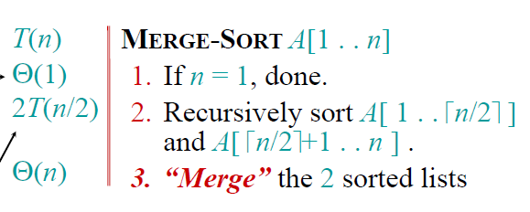
Analyzing the merge Sort
Best case=worst case=average case = O(n log n)

Slide 21
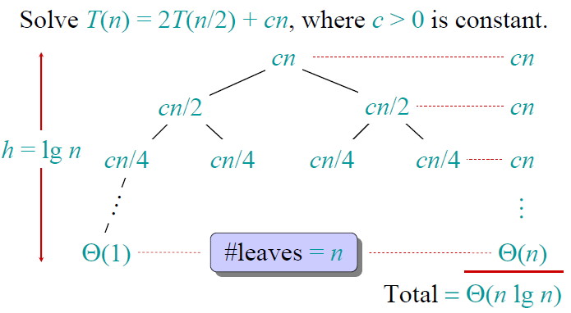
Analyzing the merge Sort (Recursion tree)

Slide 22
Conclusions
Θ(nlgn) grows more slowly than Θ(n²).
Therefore, merge sort asymptotically beats insertion sort in the worst case.
In practice, merge sort beats insertion sort for n> 30 or so.

Slide 23
Example
Given Array
2 | 5 | 8 | 4 | 7 | 6 | 1 | 9 | 3
First Sub Array
Second Sub Array
2 | 5 | 8 | 4
7 | 6 | 1 | 9 | 3

Slide 24
Example
Sorted Array Array
First Sorted Array
First Sorted Array
2 | 4 | 5 | 8
1 | 3 | 6 | 7 | 9

Slide 25
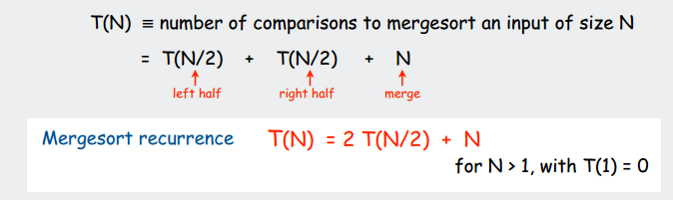
Analysis

Slide 26
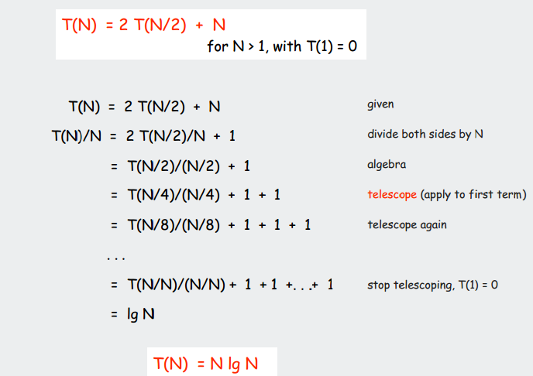
Proof
Using Telescoping Method
Notes:
Log N is actually number of times value “1” appears in final equation
T(N)/N=log(n) it implies that T(N)=N.log(N)
Note: number of values 1’s is app. Equal to log(N) where log is logarithm of base 2
Suppose log2(16)=2^4 that is power 4 and its result will be 4 so total 4 division steps required since it is divide and conquer approach
T(1)=0 means time required to divide and conquer 1 element is equal to 0

Slide 27
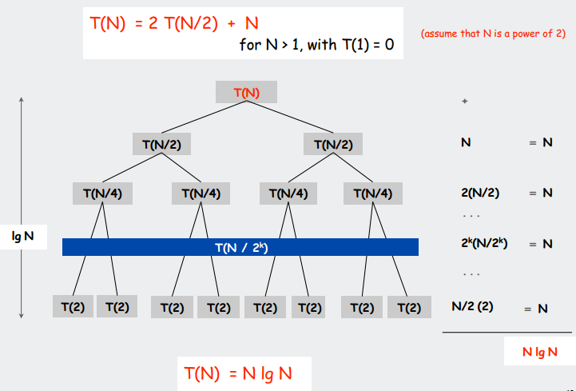
Using Recursion Tree Method
Notes:
Assume N is power for 2 means easy division that is 2,4,8,16,32,……….

Slide 28
Note Regarding Recursion Tree
Remember that in above running times logarithm of base 2 is used.
Log2(8)=3 means three levels of recursion tree
Log2(16)=4 means four levels of recursion tree
Log2(32)=5 means five levels of recursion tree

Slide 29
Merge Sort Analysis Explanation
Assumption: N is a power of two.
For N = 1: time is a constant (denoted by 1)
Otherwise: time to mergesort N elements = time to mergesort N/2 elements plus time to merge two arrays each N/2 elements.
Time to merge two arrays each N/2 elements is linear, i.e. N
Thus we have:
(1) T(1) = 1
(2) T(N) = 2T(N/2) + N

Slide 30
Merge Sort Analysis Explanation
we will solve this recurrence relation. First we divide (2) by N:
(3) T(N) / N = T(N/2) / (N/2) + 1
N is a power of two, so we can write
(4) T(N/2) / (N/2) = T(N/4) / (N/4) +1
(5) T(N/4) / (N/4) = T(N/8) / (N/8) +1
(6) T(N/8) / (N/8) = T(N/16) / (N/16) +1
(7) ……
(8) T(2) / 2 = T(1) / 1 + 1
Now we add equations (3) through (8) : the sum of their left-hand sides will be equal to the sum of their right-hand sides:

Slide 31
Merge Sort Analysis Explanation
T(N) / N + T(N/2) / (N/2) + T(N/4) / (N/4) + … + T(2)/2 =
T(N/2) / (N/2) + T(N/4) / (N/4) + ….+ T(2) / 2 + T(1) / 1 + LogN
(LogN is the sum of 1s in the right-hand sides)
After crossing the equal term, we get
(9) T(N)/N = T(1)/1 + LogN
As T(1) is 0, hence we obtain
(10) T(N) = NlogN = O(NlogN)
Hence the complexity of the MergeSort algorithm is O(NlogN).
Notes:
This log is a logarithm of base-2

